Slide 1

 | National University of Sciences & Technology (NUST) School of Electrical Engineering and Computer Science (SEECS) Department of Humanities & Sciences
Expository Writing
ENGL-101
Week 4: Lecture # 2
Course Instructor: Dr Samia Tahir
1

Slide 2

Pre-Writing Strategies
Techniques to Organize and Plan Your Writing

Slide 3

Introduction to Pre-Writing
• What is Pre-Writing?
• Importance of Pre-Writing in the Writing Process
• How Pre-Writing Helps you?

Slide 4

Prewriting is considered an intellectual architecture
Prewriting is widely considered the foundational, intellectual architecture of the writing process, serving as the critical stage where abstract thoughts are structured into a concrete, organized plan before drafting begins. Often described as "writing before writing”, this phase allows writers to move beyond mere transcription to engage in higher-order thinking

Slide 5
Brainstorming we went through in “Functional English Course”
Our focus was on:
First step: Idea generation
Second step: Idea grouping
Third step: Idea review

Slide 6
Brainstorming in Expository Writing
First step: Idea generation
Second: Idea grouping
Third: Organizing ideas logically
Fourth: Idea regrouping
Fifth: Idea review

Slide 7

Prewriting strategies we already know
Prewriting Techniques and strategies
Clustering
Listing
Freewriting
Looping
Asking yourself the six journalists’ questions.
Who?, what?, where?, when?, why?, how?

Slide 8

Organizing Ideas Logically
Chronological Order
Problem-Solution Structure
Cause-Effect Structure

Slide 9
New Prewriting Strategies
This time we will cover:
3 Perspectives
Cubing
Thinking in Similes
Relationship between the parts
Thinking outside the box

Slide 10
3 Perspectives
Looking at something from different perspectives helps you see it more completely—or at least in a completely different way, sort of like laying on the floor makes your desk look very different to you. To use this strategy, answer the questions for each of the three perspectives, then look for interesting relationships or mismatches you can explore:
1. Describe it: Describe your subject in detail. What is your topic? What are its components? What are its interesting and distinguishing features? What are its puzzles? Distinguish your subject from those that are similar to it. How is your subject unlike others?
2. Trace it: What is the history of your subject? How has it changed over time? Why? What are the significant events that have influenced your subject?
3. Map it: What is your subject related to? What is it influenced by? How? What does it influence? How? Who has a stake in your topic? Why? What fields do you draw on for the study of your subject? Why? How has your subject been approached by others? How is their work related to yours?

Slide 11
Example: Social Media Use Among University Students
Describe it (What it is): Social media use among university students refers to how students engage with platforms such as Instagram, WhatsApp, TikTok, X, and LinkedIn for communication, entertainment, learning, and self-expression. Its main components include content creation, content consumption, online interaction, and algorithm-driven feeds.
Trace it (Where it came from): Social media use among students has evolved from early platforms like Facebook, which were initially designed for university communities, to highly visual and algorithm-driven platforms such as Instagram and TikTok. Over time, its purpose has shifted from simple social networking to branding, activism, and even academic collaboration.
Map it (What it connects to): This topic is related to psychology (attention, addiction, identity formation), education (digital learning, student engagement), and sociology (peer influence, social capital). It is influenced by platform algorithms, peer norms, and institutional policies. In turn, it influences students’ study habits, mental health, language use, and political awareness.

Slide 12
Cubing
Cubing enables you to consider your topic from six different directions; just as a cube is six-sided, your cubing brainstorming will result in six “sides” or approaches to the topic.
Take a sheet of paper, consider your topic, and respond to these six commands:
Describe it.
Compare it.
Associate it.
Analyze it.
Apply it.
Argue for and against it.

Slide 13
Example: Online Learning in Universities
1. Describe it
Online learning in universities refers to the delivery of courses through digital platforms such as LMSs, video conferencing tools, and recorded lectures. It includes synchronous classes, asynchronous materials, online assessments, and virtual interaction between teachers and students.
2. Compare it
Online learning differs from face-to-face learning in terms of flexibility, physical interaction, and classroom dynamics. Unlike traditional classes, it allows students to learn from any location but offers less spontaneous discussion and social engagement.
3. Associate it
Online learning can be associated with concepts such as technology, self-discipline, accessibility, screen fatigue, digital divide, and independent learning. It also connects to ideas of globalization and lifelong learning.
4. Analyze it
Online learning consists of several elements: technology infrastructure, teaching methods, student motivation, assessment design, and institutional support. Weakness in any of these components can reduce its effectiveness, even if the platform itself is advanced.
5. Apply it
Online learning is applied in situations such as distance education, professional development programs, emergency teaching during crises, and blended learning models in universities.
6. Argue for and against it
For: Online learning increases access to education, saves travel time, and allows flexible scheduling. Against: It may reduce student engagement, increase distractions, and disadvantage students with limited internet access.

Slide 14
Thinking in Similes
In this technique, complete the following sentence:________________ is/was/are/were like ____________________.
In the first blank put one of the terms or concepts your topic centers on. Then try to brainstorm as many answers as possible for the second blank, writing them down as you come up with them.
After you have produced a list of options, look over your ideas. What kinds of ideas come forward? What patterns or associations do you find?

Slide 15
Example: Online learning is like _____
Online learning is like a self-driving car: it works well, but only if you know how to control it.
Online learning is like a library without a librarian: full of information, but guidance is limited.
Online learning is like working out at home: effective for motivated people, difficult for others.
Online learning is like watching a recorded match instead of playing: informative but less engaging.

Slide 16
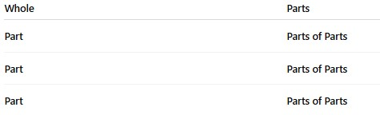
Relationship between the parts
In this technique, begin by writing the following pairs of terms on opposite margins of one sheet of paper:

Slide 17
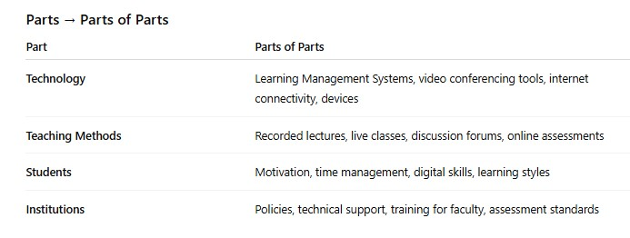
Example: Online learning

Slide 18
Thinking Outside the Box
Even when you are writing within a particular academic discipline, you can take advantage of your semesters of experience in other courses from other departments.
Let’s say you are writing a paper for an English course. You could ask yourself, “Hmmm, if I were writing about this very same topic in a biology course or using this term in a history course, how might I see or understand it differently? Are there varying definitions for this concept within, say, philosophy or physics, that might encourage me to think about this term from a new, richer point of view?”

Slide 19

Understanding the Purpose and Audience
• Define your goal (inform, persuade, explain, etc.)
• Identify your audience’s needs and expectations

Slide 20
Research and Gathering Information
• Finding credible sources
• Taking organized notes
• Avoiding information overload

Slide 21

Collaboration and Feedback
• Peer discussions
• Reviewing initial ideas with mentors or colleagues

Slide 22

Conclusion & Next Steps
• Summary of key pre-writing techniques
• Transitioning from pre-writing to drafting

